Slide 1
MANOEUVRE ENVELOPES

Slide 2
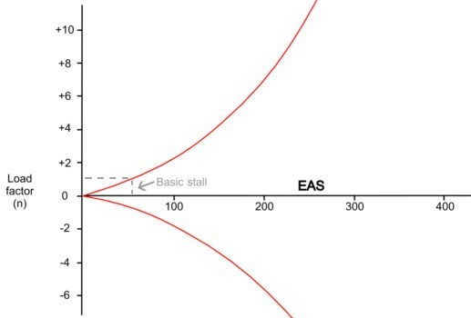
CONSTRUCTION OF ENVELOPES – MANOUVRE STALL SPEED
The formula for manoeuvre stall speed is:
The manoeuvre stall speeds can be plotted graphically with EAS on the x-axis and load factor on the y-axis.
Note that the graph starts at a load factor of 0. When the basic stalling speed (measured at 1g)) is plotted, it is apparent that flight below the basic stalling speed is perfectly feasible at load factors below one.
VM = VB √n
In the areas to the left of the manoeuvre stall speed lines, the aircraft will be stalled.

Slide 3
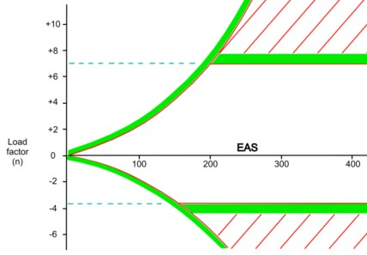
CONSTRUCTION OF ENVELOPES – LOAD FACTOR LIMITATIONS
All aircraft are designed to certain load factor requirements.
Civil aircraft category limitations are: Normal +3.80 to -1.52; Utility +4.40
to -1.76; Aerobatic + 6.0 to – 3.0 (the diagram below illustrates +7g to -3.75g).

Slide 4
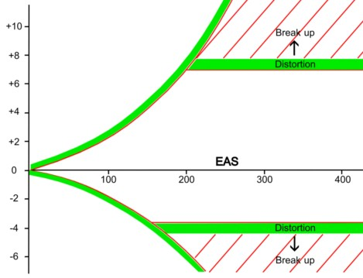
CONSTRUCTION OF ENVELOPES - LOAD FACTOR LIMITATIONS
The "g" limitations are specified for a specific mass. Should the weight of an aircraft increase, then the limiting "g" must be reduced to provide the same safety margins (e.g. increased mass of utility category light aircraft may require operation in normal category).
The "g" limitations specified for an aircraft usually have a 50% safety margin above which permanent deformation and failure may occur.

Slide 5
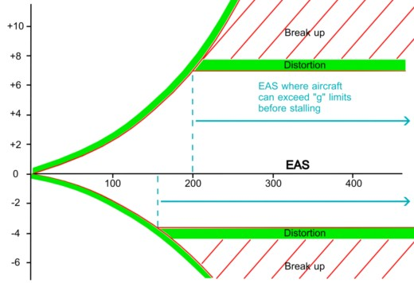
EXCEEDING LOAD FACTOR LIMITS AT AIRSPEEDS ABOVE 1“G”STALLING SPEED
From airspeeds above where the manoeuvre stall and the "g" limitation lines intersect, the aircraft can exceed the "g" limitations before stalling. Below this point the aircraft will stall before reaching the "g" limitation.
EAS limited as above

Slide 6
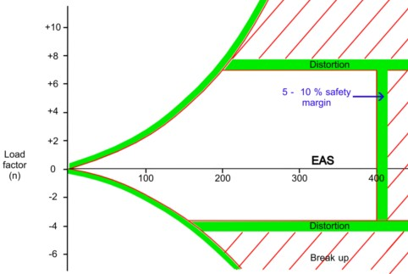
EAS LIMITATION
Every aircraft has a maximum speed limit. Beyond this limit the aircraft may be damaged, ranging from losing panels to total structural failure. Again there is a safety factor (5 - 10%) built in.

Slide 7
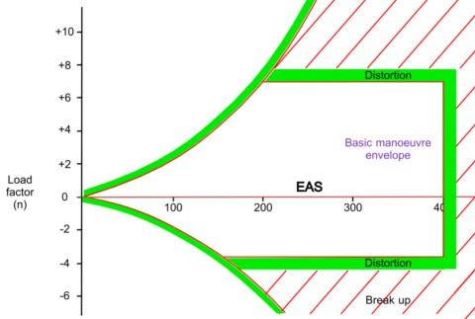
This completes the basic manoeuvre envelope. Operations outside the basic manoeuvre envelope are either impossible or unsafe.

Slide 8
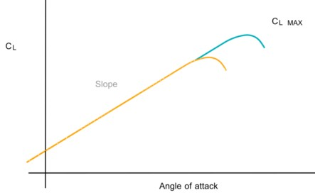
FACTORS CREATING REDUCED CLmax
The basic manoeuvre envelope has been constructed on the assumption that the
maximum value of CL is always the same. But there are several factors that can
reduce the value of CL max; they include:
1. Relative airflow compressibilty / shock waves at high angles of attack;
2. Adverse boundary layer and handling issues at high angles of attack.

Slide 9
COMPRESSIBILITY
Consider an aerofoil moving through the air. The velocity of
the airflow is the greatest in the flow close to the aerofoil.
If the free stream flow is close to the speed of sound, the
airflow close to the wing may be supersonic. The associated
compressibility and shock wave issues will reduce the
useable value of CL max.
The reduction in CL max due to compressibility increases as
mass, altitude (or more generally TAS) increases, and occurs because the acceleration of the airflow over the wing is the greatest at high angles of attack.

Slide 10
BOUNDARY LAYER
At high angles of attack the separation point moves forward, thickening the boundary layer and accelerating the process of flow separation from the wing.
The fluctuating wake behind the wing decreases the effectiveness of the elevator, making it difficult to hold accurate attitudes at those high angles of attack.
Swept wing aircraft experience pitch–up moments at such high angles of attack, mostly due to wing tip stalling and consequent inward / forward wing centre of pressure movement.

Slide 11
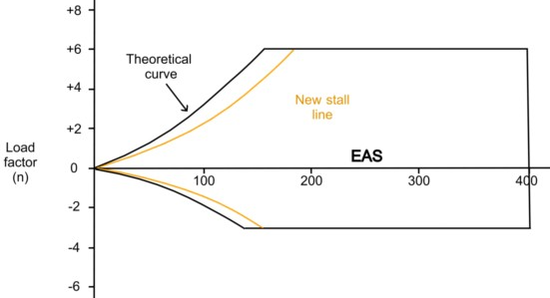
BOUNDARY LAYER / MODIFIED MANOUVRE ENVELOPE
Angles of attack close to the stall are therefore unusable, reducing CLmax.
The manoeuvre envelope must therefore be modified.
Because CL max is reduced, new stall lines (with positive and negative load factors) must be drawn in. These lines will be applicable to sea level.

Slide 12
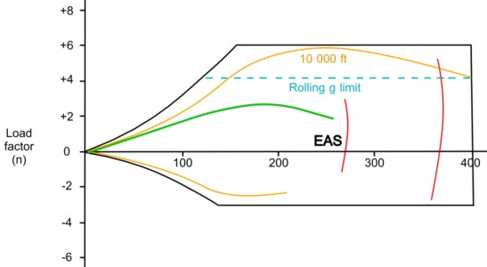
LOAD FACTOR LIMIT WHILE ROLLING
The rolling “g” limit provides a safety margin against structural failure because the wing structure must provide strength to withstand the twisting forces caused by the roll control deflection besides providing strength to withstand the normal "g".
30000 ft
10000 ft
Mach limits
10000ft

Slide 13
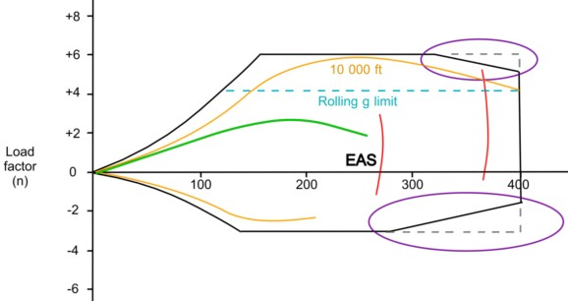
EAS BUFFET CORNERS
If high air loads (EAS) are combined with high load factor, the weakest part of the structure is more likely to fail. In the case of the tailplane, this will be further aggravated if it is buffeted by the turbulent wake of the wings.
This buffeting requires the maximum load factors to be reduced at high EAS. To facilitate this, buffet corners are incorporated into the manoeuvre envelope.
30000 ft
30000 ft
10000 ft
10000 ft

Slide 14
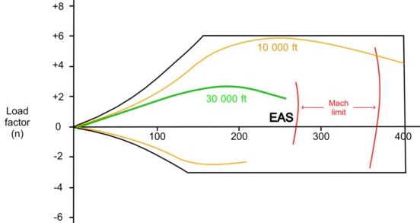
MODIFIED MANOEUVRE ENVELOPES
Mach limit lines are drawn for each altitude because altitude changes EAS / Mach relationship.
The mach limit lines are curved because load factor affects compressibility, which in turn affects CL max
At high angles of attack (load factor) relative airflow over the wing becomes sonic earlier. The mach limit will be reached at a lower EAS.
Shock waves
Shock waves are formed when the airflow at any point on the aircraft, but usually on the wings, reaches the speed of sound. The air is then "bunched" together as a wave. Inside this wave, there are drastic changes in pressure and the speed of the airflow.
As the stall lines change with altitude, so they will also change with changing aircraft mass. Note that the stall lines are also called the lift boundary lines.
As an aircraft has an upper limit in its speed range (EAS), so it will also have an upper limit pertaining to Mach number.
This limitation is due to compressibility and the formation of shock waves.
Since the value of CL max reduces with altitude, new curves must be drawn for higher altitudes, for example10 000 feet and 30 000 feet.
10000 ft
30000 ft
10000ft

Slide 15
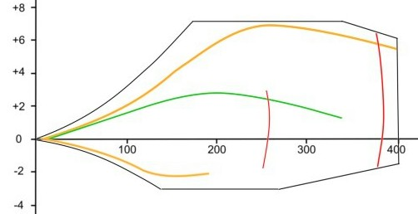
MODIFIED MANOEUVRE ENVELOPES
The basic manoeuvre envelope has now been modified to incorporate a large amount of extra information. The graphic below presents the completed envelope.
10000 ft
Rolling “g” limit
30000 ft
30000 ft
10000 ft
Mach limits
10000 ft

Slide 16
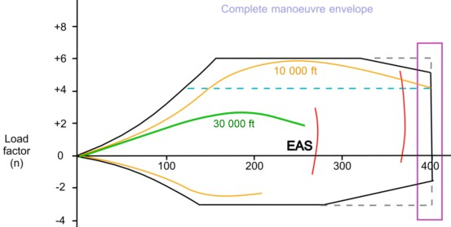
INFORMATION FROM MANOEUVRE ENVELOPES
The following basic limitations can be read from the envelope:
Maximum EAS 400 kts
Rolling g limit
Mach limits
30000 ft
10000 ft

Slide 17
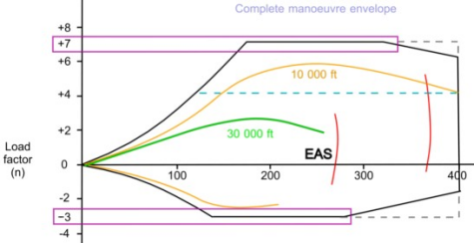
INFORMATION FROM MANOEUVRE ENVELOPES
▪ Maximum permitted load
factor. (+7 and - 3 g)
Rolling g limit
Mach limits
30000 ft
10000 ft
10000ft

Slide 18
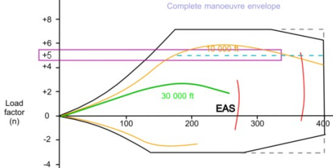
INFORMATION FROM MANOEUVRE ENVELOPES
Take the following example:
The aircraft is recovering from a dive at 6g and 350 kts. During the recovery, the
aircraft is rolled in to a turn while maintaining that load factor. The rolling g limit
has been exceeded.
Rolling g limit (+5g)
Mach limits
30000 ft
10000 ft
10000ft

Slide 19
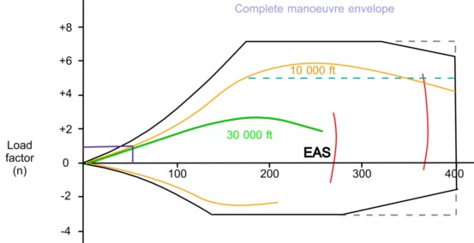
INFORMATION FROM MANOEUVRE ENVELOPES
Basic stalling speed (at 1 g). (Approximately 55 knots
Rolling g limit
Mach limits
30000 ft
10000 ft
10000ft

Slide 20
INFORMATION FROM MANOEUVRE ENVELOPES
Available load factor at any height and speed. (eg. 240 knots at 10 000 feet gives +6 g)
Rolling g limit
Mach limits
30000 ft
10000 ft
10000ft

Slide 21
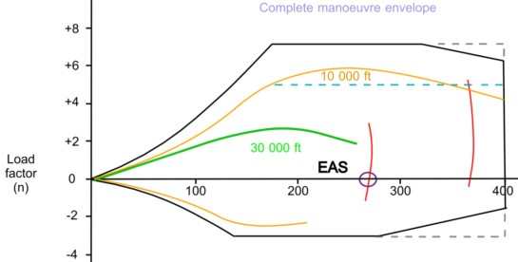
INFORMATION FROM MANOEUVRE ENVELOPES
Maximum EAS at any height. (eg. 270 knots at 30 000 feet)
Rolling g limit
Mach limits
30000 ft
10000 ft
10000ft

Slide 22
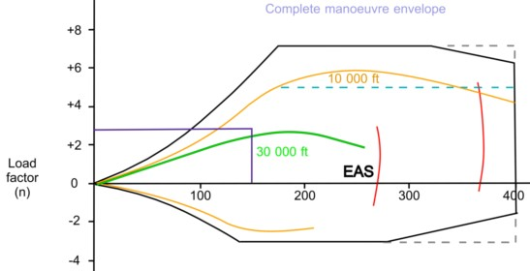
INFORMATION FROM MANOEVRE ENVELOPES
Stall speed at any height and load factor.
eg. 3g at 10 000 feet gives a stall speed of 120 knots
Rolling g limit
Mach limit lines
30000 ft
10000 ft
10000ft

Slide 23
DESIGN MANOUVRING SPEED (VA)–Tail Plane Is The Structural “Weak Link”
DEF’N: The highest speed at which sudden and full nose up elevator deflection can be made
without exceeding the design limit load factor.
The manouvre stalling speed in this situation = Vs (1g) x √N where N = load factor, and
Vs (1g) is the straight and level stalling speed when N =1.
E.G If limiting load factor (N) for the aircraft in this diagram is 3.8, and Vs(1g) is 71 kts for an
aircraft mass of 9500kgs then VA = 138 kts.
Full elevator application at
138 kts or less would stall
the aircraft before N > 3.8.
Reduction of aircraft mass
to 5700 kgs, then Vs(1g)
would be 55 kts; and at N =
3.8, VA = 107kts.
I.E: Increase aircraft mass:
Increase VA; and vice versa.
NOTE: CHANGING AIRCRAFT MASS REQUIRES A NEW DIAGRAM
N = 3.8
Vs1g =
71 kts
VA =
138kts

Slide 24
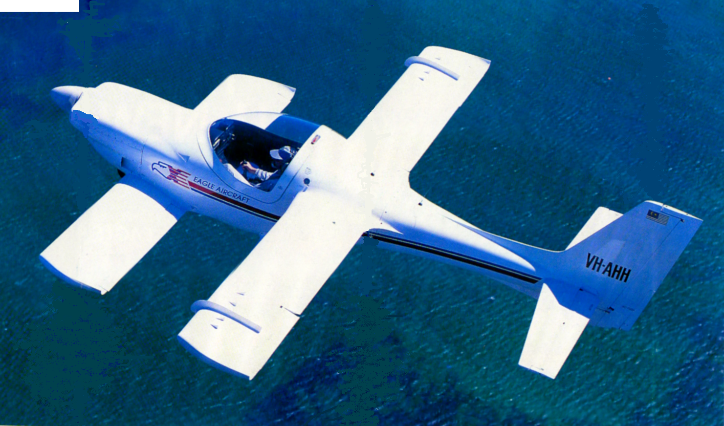
DESIGN TURBULENCE PENETRATION SPEED (VB)
That speed at which, upon encountering a positive or negative 66 feet / second vertical gust, the
aircraft will stall before exceeding either positive or negative design limit load factor - a low speed.
The aircraft must meet the requirement above and satisfy the same requirement to stall upon encountering a 50 feet /second gust at Design Cruise Speed (Vc) (minimum 43 kts faster than VB).
Operational Rough Air Speed
(VRA / MRA) is high enough to
meet the requirements above
without stalling in a 66 feet
per second gust.
The aircraft must also stall
before overstressing upon
encountering a 25 ft /sec
positive or negative
vertical gust at Design
Dive Speed (VD) .

